Slide 1
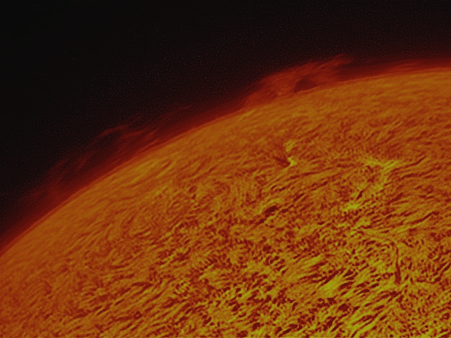


Photon Sieves for High-Resolution Imaging
Laura Dunlap, University of Maryland
SESI Final Presentation 2012
Notes:
I began this project last summer, and I have been working on it since then. So I will do my best to put 15 months of work into 10 minutes. I’ll try to give you the big picture of my project.

Slide 2
Motivation
We want…
…to know more than we already know about the universe
…to see in more detail than we’ve seen before
…to look back even further in time
But we can’t see more than our optics will allow.
How do we improve the resolution of our optics?

Slide 3
Bigger IS Better!
Resolution largely depends on diameter:
θ = λ/D
But there are problems with making large lenses and mirrors…
    Weight
    Cost
    Too big for spacecraft
    Hard to make
Notes:
When it comes to resolution, bigger IS better! The angular resolution, so how much detail you can get, is largely dependent on the size of the optic. The basic formula is here. Theta is the smallest resolvable angle, so we want theta to be small. To do that, we must make D large. However, in reality there is a limit to this size. First, large lenses and mirrors get heavy. They are expensive, and it would be even more expensive to fly a heavy mirror on a spacecraft. For that matter, there are so many more complications with putting a big mirror on a spacecraft. In addition, these big traditional optics call for extreme detail on their curvature and surface flatness, and this becomes more difficult to manufacture as the optic gets bigger.

Slide 4
Question:
How do we get bigger optics in space?
Notes:
So how do we get past these limitations and fly a bigger optic in space? We don’t want to just accept we’ve seen all we can.

Slide 5
Answer:
Photon Sieves!
(and other deployable diffractive membrane optics…)
Notes:
The answer is photon sieves!

Slide 6
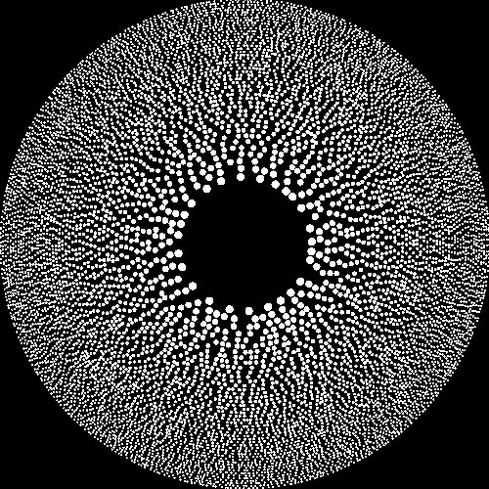
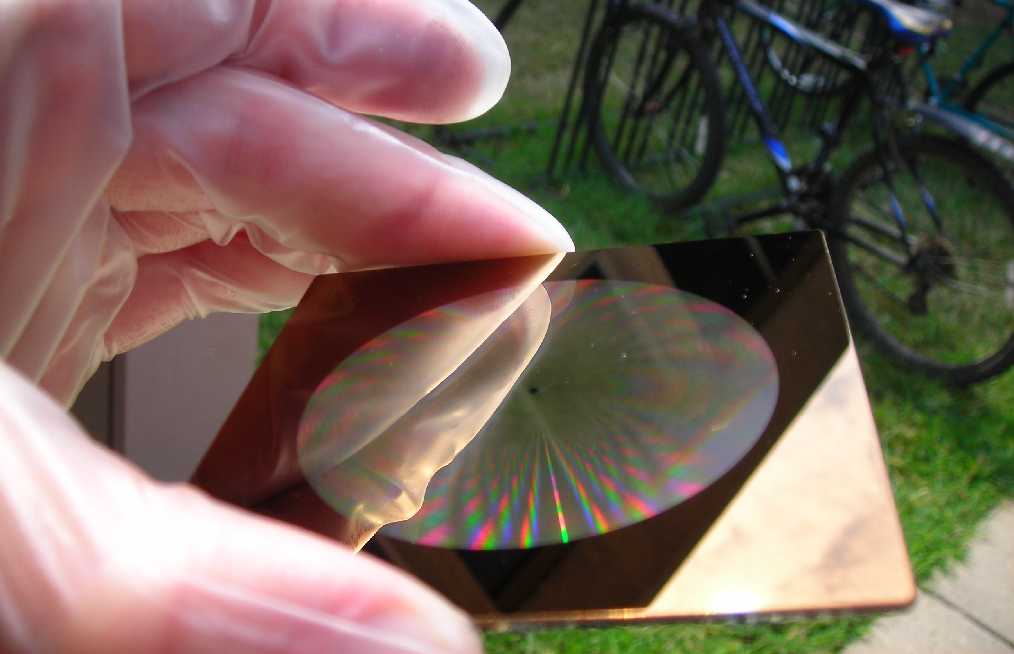
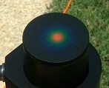
What is a Photon Sieve?
Notes:
What is a photon sieve? It is a diffractive optic, meaning it focuses light using diffraction instead of refraction or reflection like a lens or a mirror. It is produced on a flat piece of glass or flexible membrane and consists of millions of tiny holes of decreasing size.

Slide 7
How Does it Work?
Light passes through the holes and diffracts around the edges
- holes can be transparent material or physical holes
Constructive interference from the diffracted waves results in an image at the focal point
Focal length f determined by the wavelength of light λ, distance to outermost zone r_{N}, and width of outermost zone Δr_{N} such that:
2r_{N}Δr_{N}
f =
λ
Every wavelength has a unique focus!

Slide 8
Advantages
Can be produced on a flexible membrane
  Lightweight
  Easily deployable (think of a coffee filter)
  Can be much bigger than spacecraft
Less strict surface tolerance
Perfect for narrow-band imaging alone or broadband imaging with additional corrective optics

Slide 9
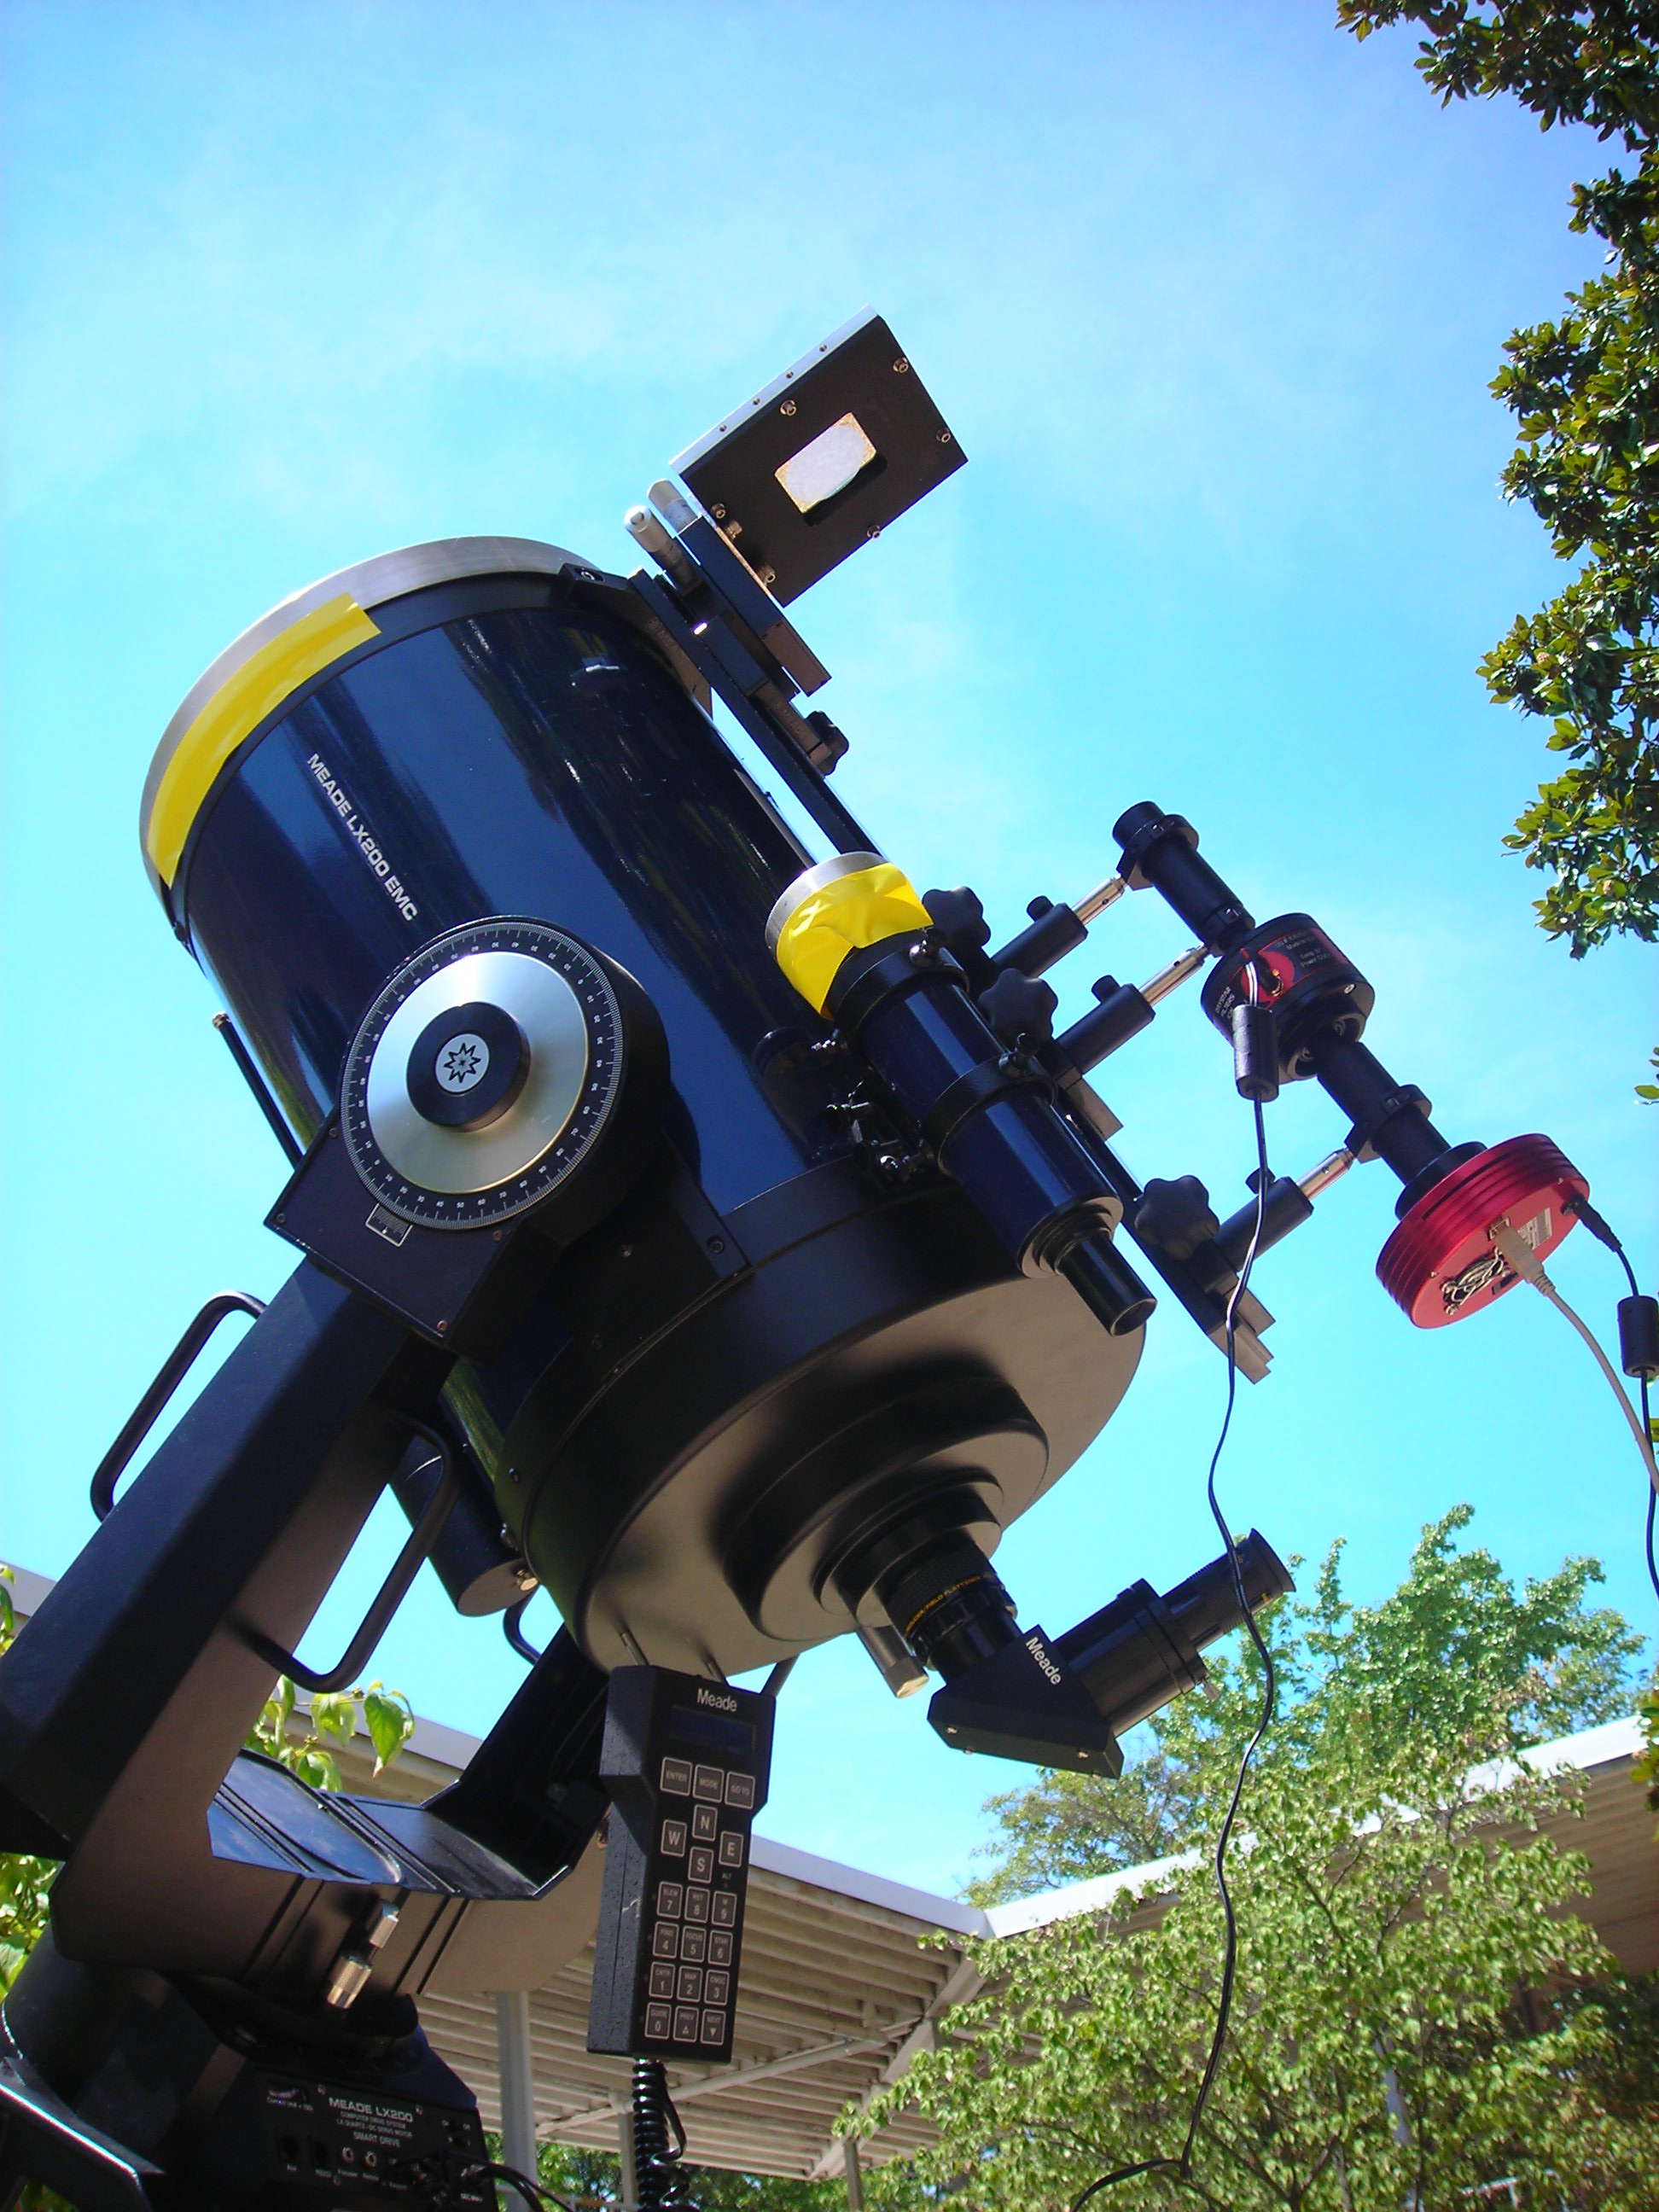
Imaging Process
Sunlight passes through the sieve and is collimated by the first lens
Collimated beam passes through the DayStar filter
The second lens focuses the beam and forms an image on the camera’s CCD
H-alpha (656.3 nm) image
2x magnification
In order to accurately track the Sun, the optical system was piggybacked on a Meade LX200 telescope (above)

Slide 10
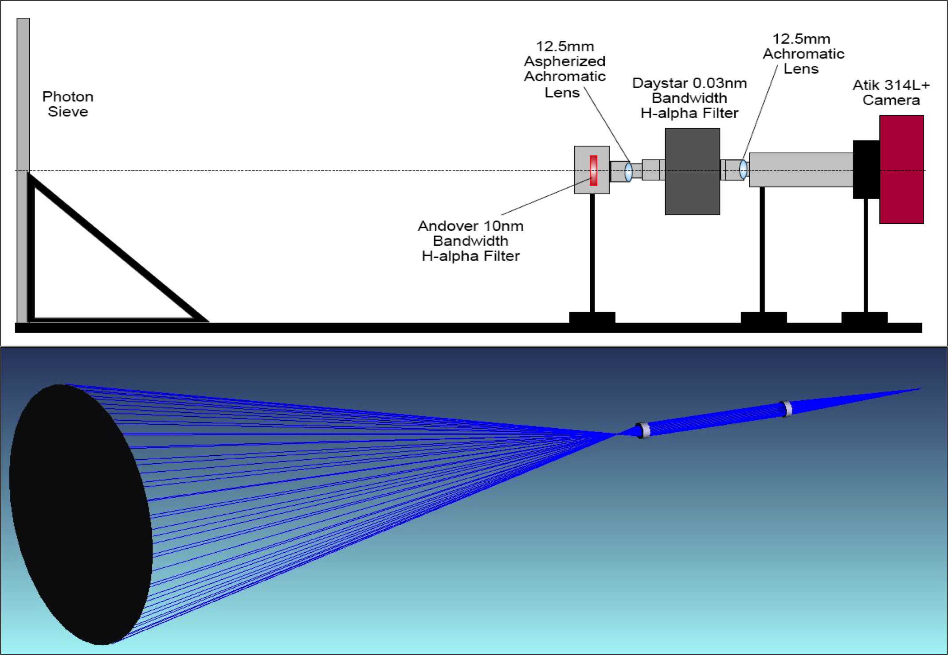
Notes:
Here is just a blow up of the system and a ray diagram to reiterate what I just said. The light is focused by the sieve, collimated by the first lens as it is sent through the filter. Then the second lens focuses the filtered light on the CCD. It is important that the light is collimated as it goes through the filter so that there are no weird effects from off angled light. We chose h-alpha because it shows a lot of good solar features.

Slide 11
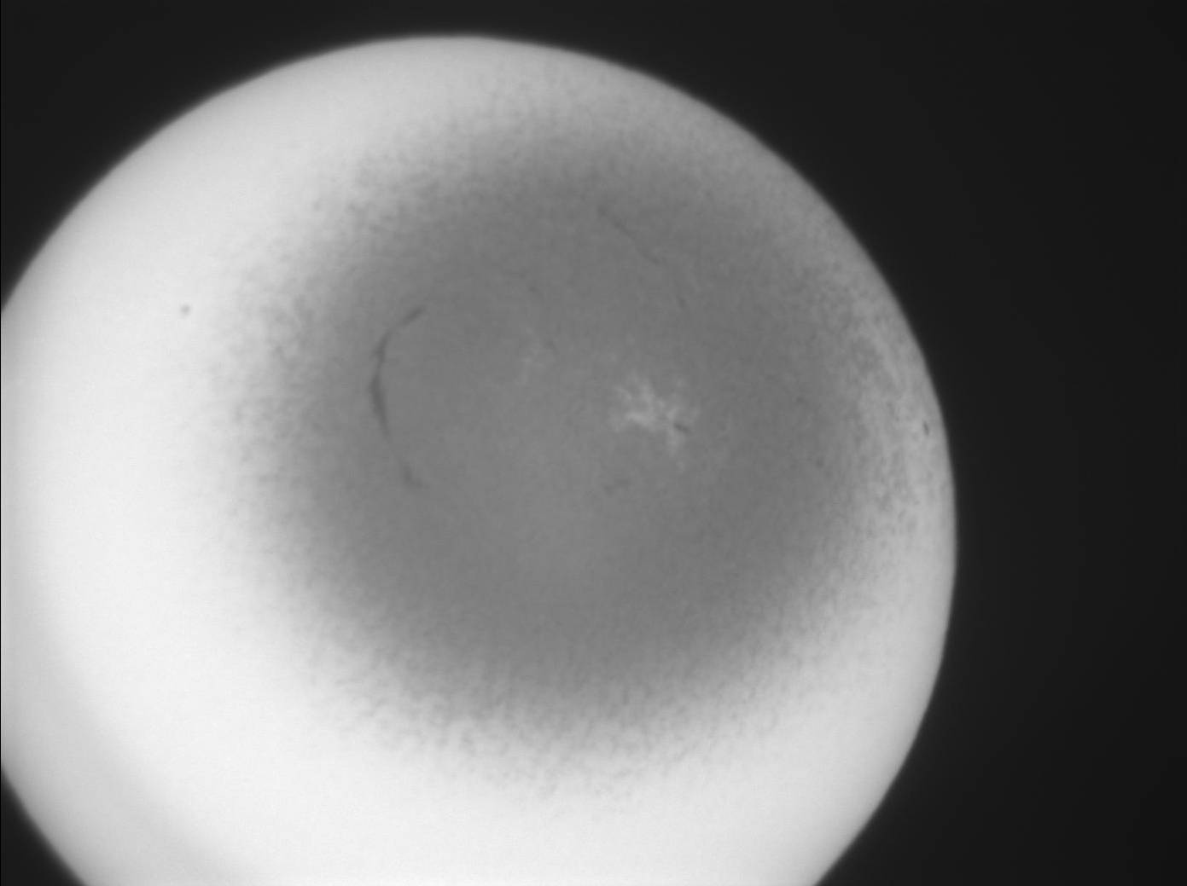
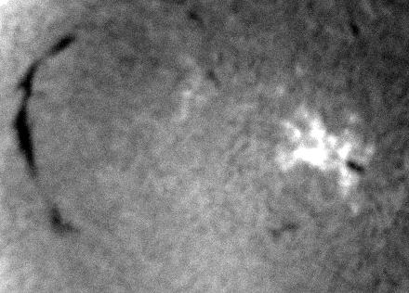
Full image taken with photon sieve →
Detailed image of center of field of view
←

Slide 12
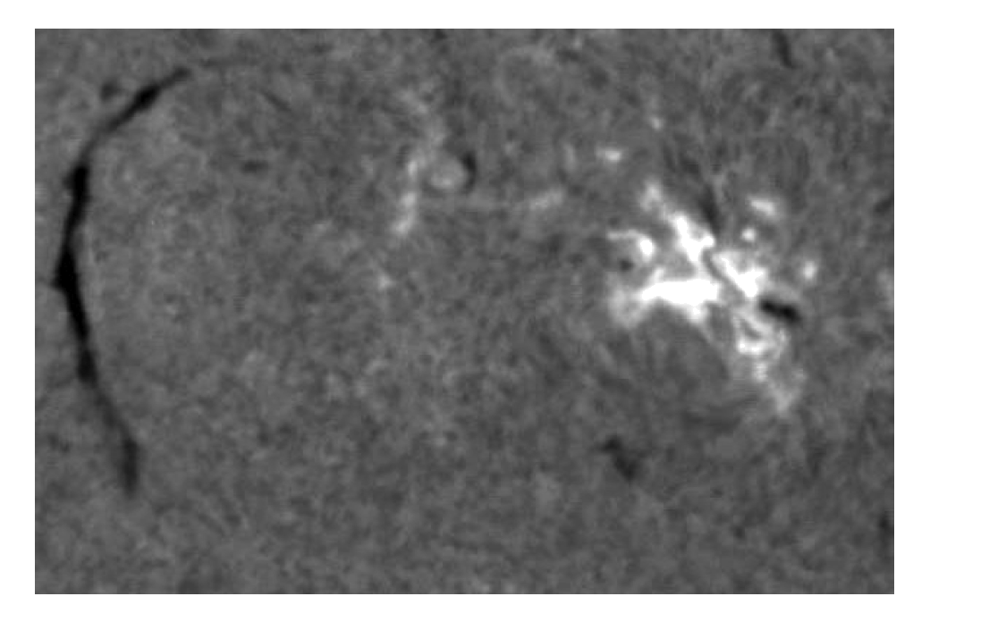
How did we do?
Image taken with photon sieve in Greenbelt, MD
Image taken by Big Bear Solar Observatory (~ 2 arcsec resolution)
Approximately 3 arcsec resolution with 6 +- 3% transmission

Slide 13
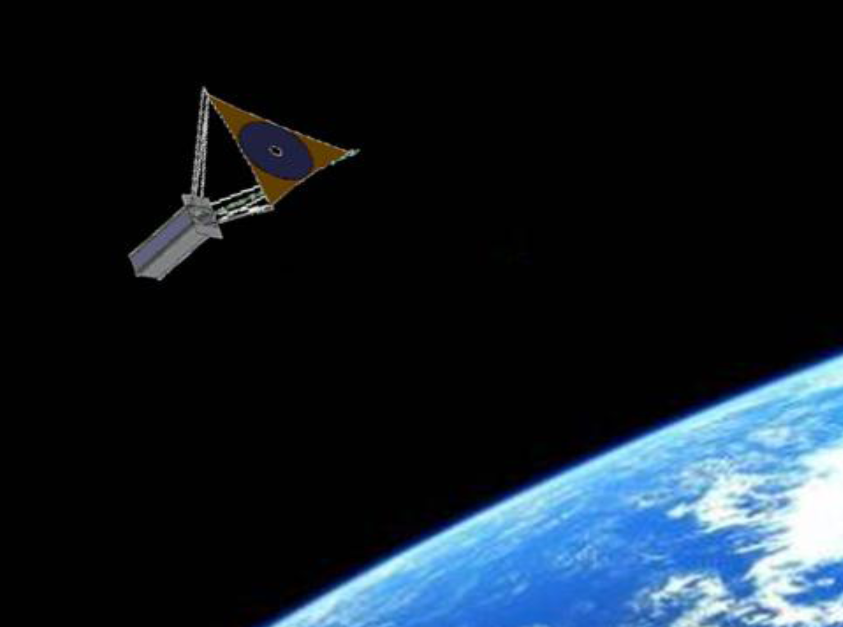
Looking Forward
Technology demonstration
  →US Air Force Academy will fly photon sieve on CubeSat
  →Promote production of more photon sieve imaging systems
10 meter diameter photon sieve
→ 0.01 arcsec resolution!
Extreme ultraviolet (EUV) and X-ray sieves
→ This area of the spectrum is nearly impossible to image with traditional optics

Slide 14
Thanks!
Mentors: Adrian Daw and Doug Rabin
Courtney Peck, Juliana Vievering
Dr. Verner and the SESI Program

